Slide 1
Video Streaming Pipeline
August 27th, 2020
Bartek Pawlik

Slide 2
Agenda
Business Objective
Architecture
Solution Overview
CVML Inference
Demo
Appendix

Slide 3
Business Objective
With this solution you’re be able to:
Stream from multiple cameras to Kinesis Video Streams (KVS)
Write camera streams in chunks to the local storage
Retrieve video chunks by time range, concatenate them and upload to the cloud, either to S3 or to KVS
Perform real-time ML inference on camera streams
Preview camera streams and inference results in web browser
Turn above features ON or OFF on-demand any time

Slide 4
Architecture

Slide 5
Solution Overview
Multi-camera support
Supports any camera source (USB, IP, CSI, video files, etc.)
Write camera streams to local storage:
Video stored in chunks with 1 second accuracy
Purge old files after N days
API to retrieve videos within given time range (as video segments and merged into single video file)
Video streaming directly to KVS
Local network video streaming through HLS
Real-time ML inference
Web client to configure, preview and send requests to the cameras

Slide 6
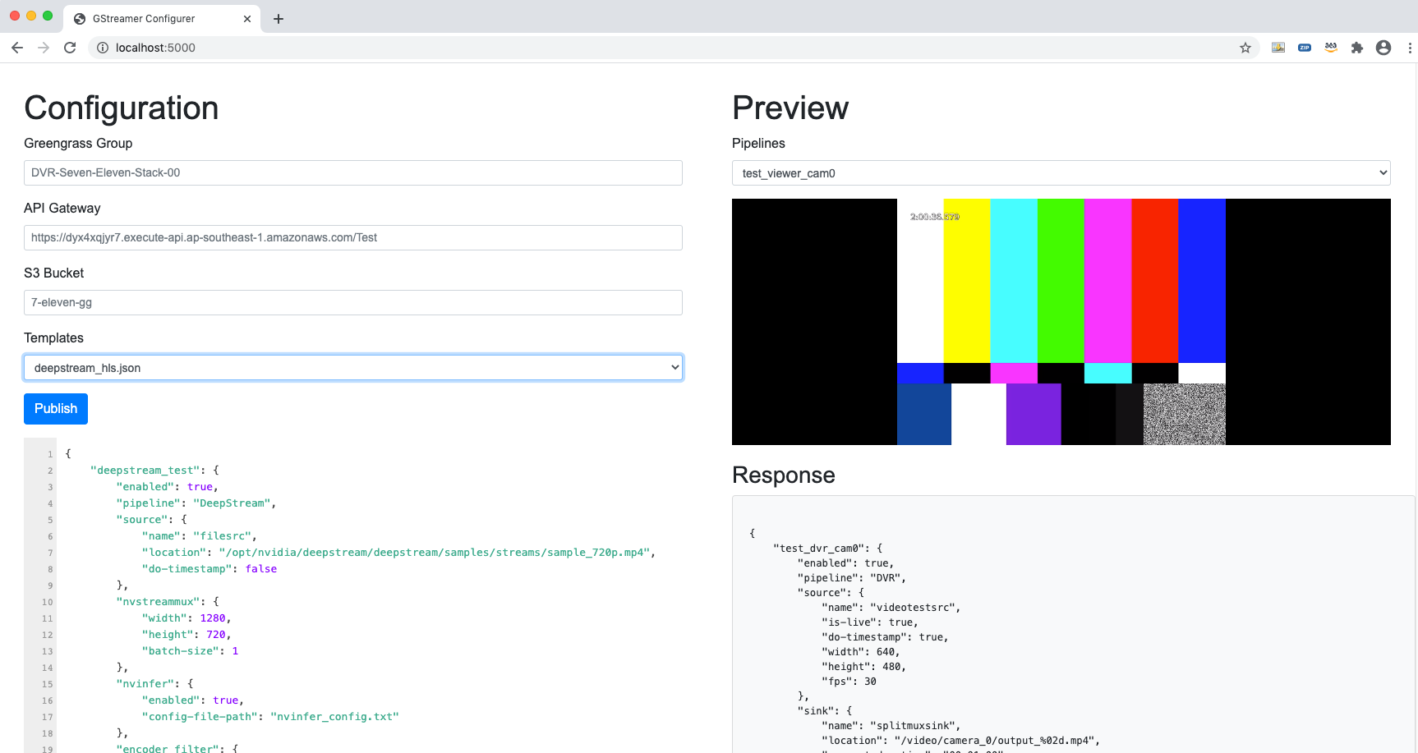
Demo

Slide 7
CVML Inference
Inference can be performed on frame-by-frame basis using any of the popular Python neural network frameworks:
TensorFlow
Keras
MXNet
Neo DLR
etc.
Custom plug-ins for Neo DLR and GluonCV / MXnet provided
Support Nvidia DeepStream SDK ML engines and models

Slide 8
Appendix

Slide 9
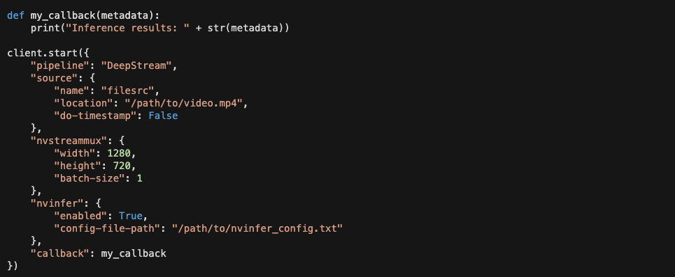
CVML Inference
Example usage for Nvidia DeepStream SDK:

Slide 10
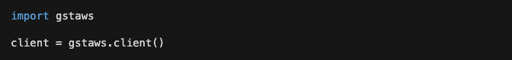
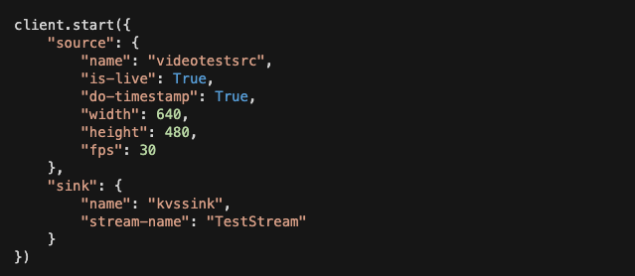
API
All video functionality wrapped into a Python/C SDK
Similar usage to greengrasssdk:

Slide 11
Thank You

